Slide 1

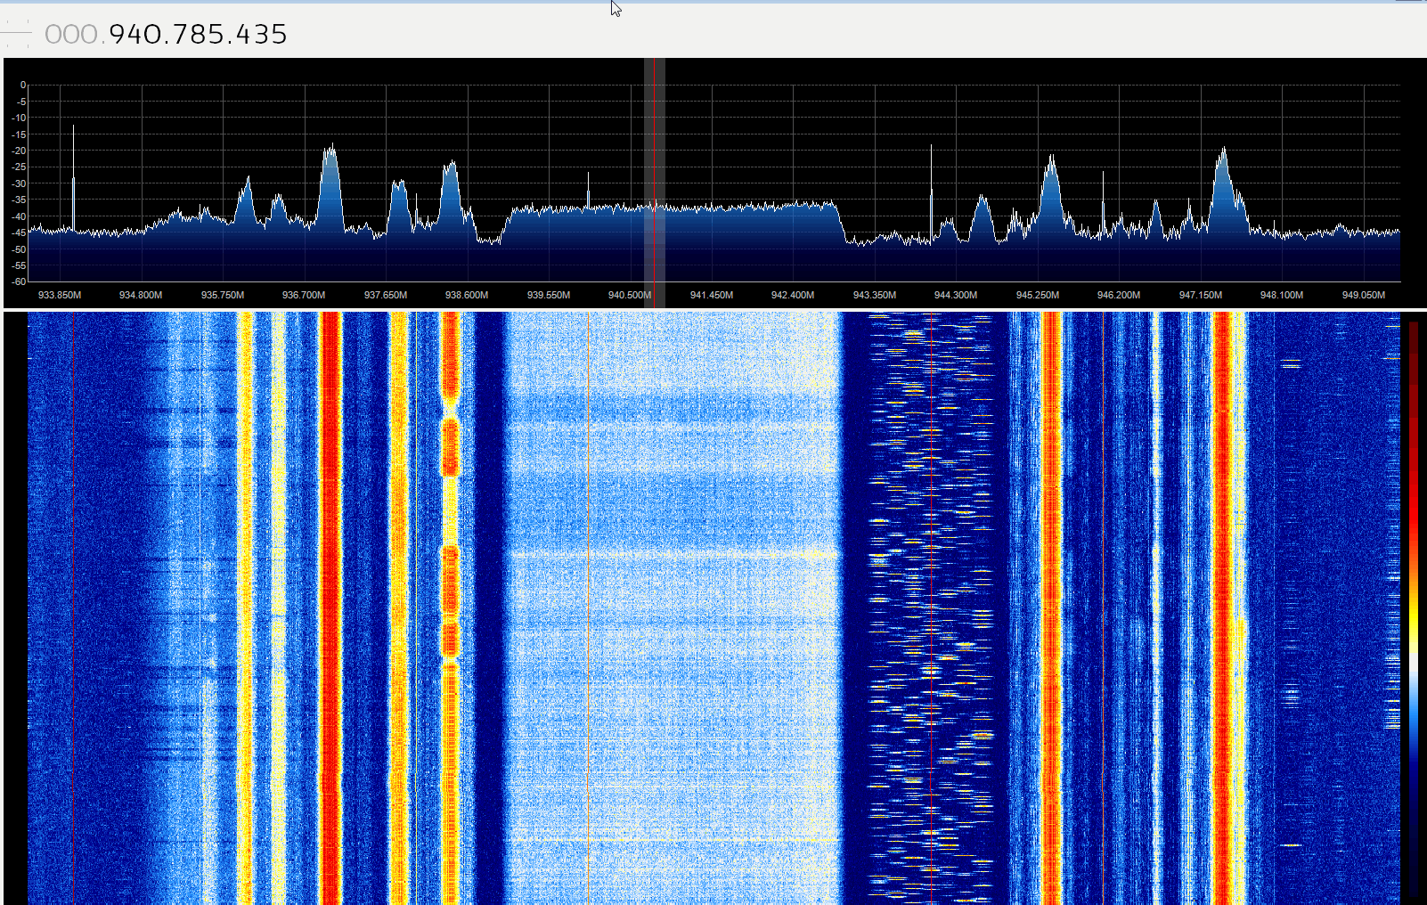
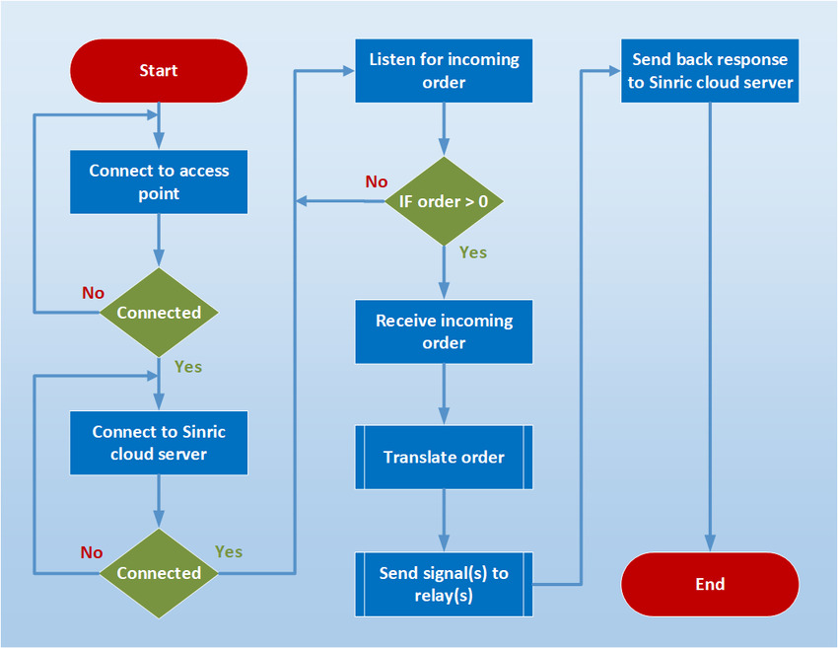
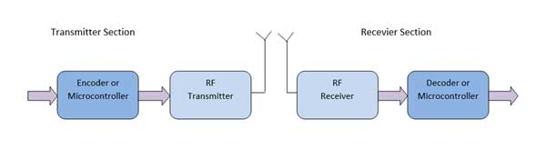
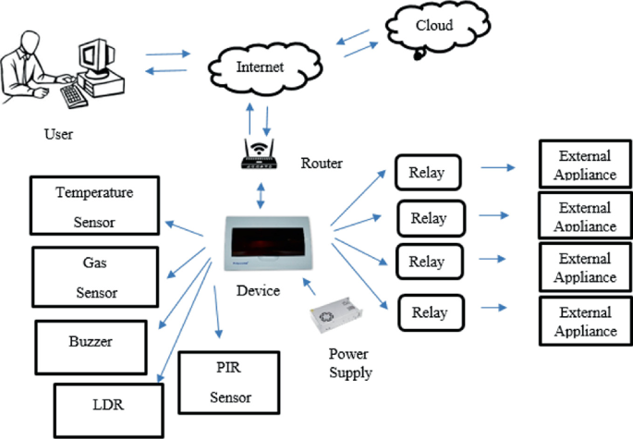

Mohamad Monzer [10120048]
Supervisor:Dr Kasem.Danash
Modernizing remote control mastery. Its ease and
danger to individual security and its treatment.
PROJECT BACKGROUND AND MOTIVATION
This paper proposes a solution to enhance the security of RF remote control systems by integrating server-side processing, enabling centralized decision-making and advanced security measures. By transmitting commands securely to servers, manufacturers can mitigate the vulnerabilities associated with RF signals, offering a more secure and reliable remote-control experience.
AIMS AND OBJECTIVES
KEY RESULTS OR OUTCOMES -1
Motivated by a desire to bridge the gap between theoretical knowledge and real-world applications, my project embodies the spirit of innovation and exploration. By integrating diverse technologies, from secure MQTT to HTTPS protocols, I aim to create a holistic solution that not only addresses existing challenges but also paves the way for future advancements in the field of computer science.
Signal Interception Methods:
Sniffing Devices
Replay Attacks
Signal Jamming
Centralized Security Management:
Servers centralize security measures, allowing for consistent enforcement of encryption and authentication protocols.
Dynamic Updates:
Servers facilitate rapid deployment of security patches and updates across all connected devices, reducing vulnerability windows.
Multi-Factor Authentication:
Integration of multi-factor authentication adds an extra layer of security against unauthorized access.
Audit Trails and Monitoring:
Server-side processing enables detailed audit trails and monitoring, aiding in security incident detection and response.
Scalability and Resource Optimization:
Servers offer scalability and efficient resource management to handle growing numbers of connected devices while maintaining security standards.
PROJECT DESIGN /METHODOLOGY
remote control flow diagram
Technologies Used
Software Features
C# Windows App
Backend Server
Android App
Interfacing: Integration with external devices such as Raspberry Pi, IR/RF modules, and RF interceptor.
The software offers a wide range of functionalities including device pairing, remote signal interception, decoding, and relay control via the Windows application. The Android app provides remote access and control.
PROJECT IMPLEMENTATION
User Interaction
The C# application controls IR/RF remotes via a Raspberry Pi server. The Android app acts as a notification receiver, establishing secure communication with the C# app. This setup enables functionalities like secure phone location tracking.
Software Architecture: Hybrid Architecture Overview
The software combines elements of a client-server model with a C# Windows application as the primary client, backed by a server managed through Visual Studio Code. Additionally, an Android application
Conclusion
In conclusion, opting to integrate servers rather than relying on RF or IR remotes to control smart devices represents a strategic move towards enhanced security and functionality. By leveraging server-based solutions, organizations can fortify their systems against interception and unauthorized access, mitigating potential risks associated with outdated remote control technologies. This shift not only bolsters confidence in the system's reliability but also paves the way for improved user experiences and streamlined operations. Embracing server integration underscores a commitment to innovation and adaptability in an ever-evolving technological landscape, positioning businesses and users alike for greater efficiency, convenience, and peace of mind.

